Slide 1
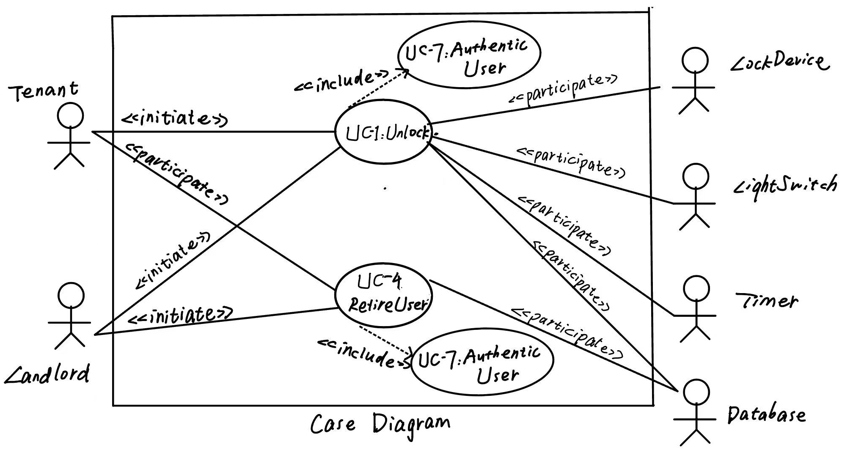
Assignment_1 10215101459 胡云舒
• Draw use case diagram for UC-1 (Unlock) and UC-4 (RetireUser)

Slide 2
• Write the use case schemas of UC-1 and UC-4
Use Case UC-1: |  |  | Unlock
Related Requirem’ts: |  |  | REQ1, REQ3, REQ4, and REQ5 stated in the table of REQs
Initiating Actor: |  |  | Any of: Tenant, Landlord
Actor’s Goal: |  |  | To disarm the lock and enter, and get space lighted up automatically.
Participating Actors: |  |  | LockDevice, LightSwitch, Timer, Database
Preconditions: |  |  | • The set of valid keys stored in the system database is non-empty. • The system displays the menu of available functions; at the door keypad the menu choices are “Lock” and “Unlock.”
Postconditions: |  |  | The auto-lock timer has started countdown from autoLockInterval.
Flow of Events for Main Success Scenario:
→ | 1. | Tenant/Landlord connects the phone to the door and selects the menu item “Unlock”
 | 2. | include::AuthenticateUser (UC-7)
← | 3. | System (a) signals to the Tenant/Landlord the lock status, e.g., “disarmed,” (b) signals to LockDevice to disarm the lock, and (c) signals to LightSwitch to turn the light on
← | 4. | System signals to the Timer to start the auto-lock timer countdown
→ | 5. | Tenant/Landlord (a) opens the door and (b) breaks the link between the phone and the lock.

Slide 3
Use Case UC-4: |  |  | RetireUser
Related Requirem’ts: |  |  | REQ3 and REQ7 stated in the table of REQs
Initiating Actor: |  |  | Landlord
Actor’s Goal: |  |  | To retire an existing user account and disable access.
Participating Actors: |  |  | LockDevice, LightSwitch, Timer, Database
Preconditions: |  |  | • The set of valid keys stored in the system database is non-empty. • The user should be in the database already.
Postconditions: |  |  | • The deleted records should be logged in the database.
Flow of Events for Main Success Scenario:
→ | 1. | Landlord selects the menu item “Remove User” on his phone.
 | 2. | include::Login (UC-8)
← | 3. | System display all the users.
→ | 4. | Landlord chooses the target and submits.
← | 5. | System receives the target and sends a confirmation message to prevent accidental deletion.
→ | 6. | Landlord (a) confirms the message or (b) cancels the removement operation.
← | 7. | • If Landlord confirms the command, then System (a) removes the target from database and (b) updates the log. • If Landlord cancels the operation, then System go back to the main page.
→ | 8. | Landlord (a) removes the user and (b) breaks the link between the phone and the lock.

Slide 4
• Write the acceptance tests for UC-1 and UC-4
Test-case Identifier: | TC-1
Use Case Tested: | UC-1, main success scenario, and UC-7
Pass/fail Criteria: | The test passes if the user enters a key that is contained in the database, with less than a maximum allowed number of unsuccessful attempts.
Input Data: | Numeric keycode, door identifier
Test Procedure: |  | Expected Result:
Step 1. Type in an incorrect keycode and a valid door identifier |  | System beeps to indicate failure; records unsuccessful attempt in the database; prompts the user to try again
Step 2. Type in the correct keycode and door identifier |  | System flashes a green light to indicate success; records successful access in the database; disarms the lock device

Slide 5
Test-case Identifier: | TC-4
Use Case Tested: | UC-4, main success scenario, and UC-7
Pass/fail Criteria: | The test passes if the user enters a key that is contained in the database, with less than a maximum allowed number of unsuccessful attempts and choose the target user correctly.
Input Data: | Numeric keycode, door identifier, and target user
Test Procedure: |  | Expected Result:
Step 1. Type in an incorrect keycode and a valid door identifier. |  | System returns the message “login in succsesfully” System remove the target user.
Step 2. Choose the target user correctly.

